Slide 1
Multiprocessors
Nhóm 1
1870583 Chu XuânTình
1870584 Trần ThànhĐạt
1870387 Lê vănDuẫn
1970017 PHAN VĂN HƯNG
1670967 NGUYỄN NGỌC THÀNH
1970133 TRẦN QUỐC TRÍ

Slide 2
Reading Assignment 1
2

Slide 3
Outline
Definition
Memory consistency
Synchronization
Multithreading

Slide 4
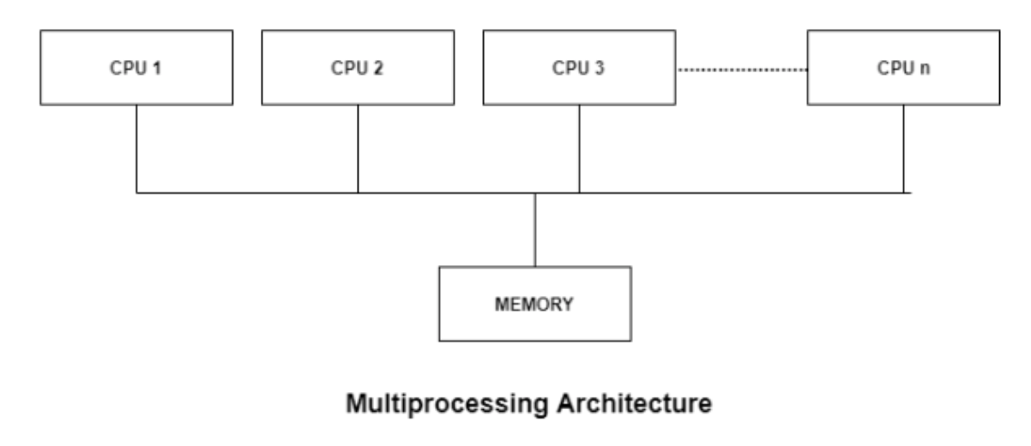
What is multiprocessor system?
Most computer systems are single processor systems i.e they only have one processor. However, multiprocessor or parallel systems are increasing in importance nowadays. These systems have multiple processors working in parallel that share the computer clock, memory, bus, peripheral devices etc

Slide 5
Parallel architecture taxonomy
Phân loại kiến trúc máy tính (Michael Flynn -1966)
SISD - Single Instruction Stream, Single Data Stream
SIMD - Single Instruction Stream, Multiple Data Stream
MISD - Multiple Instruction Stream, Single Data Stream
MIMD - Multiple Instruction Stream, Multiple Data Stream

Slide 6
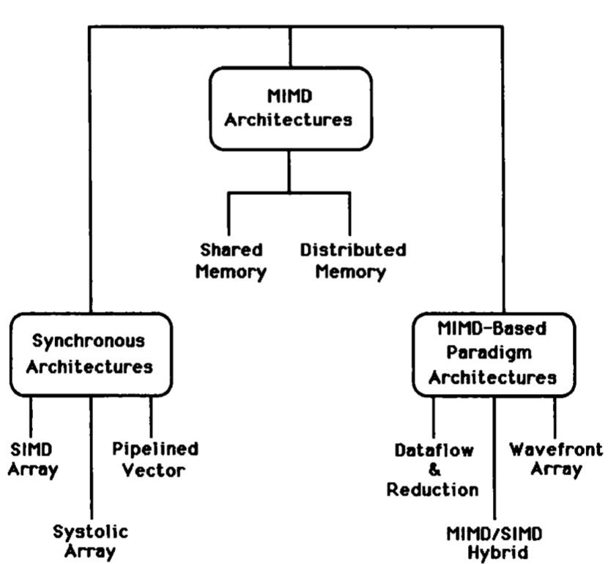
Parallel architecture taxonomy

Slide 7
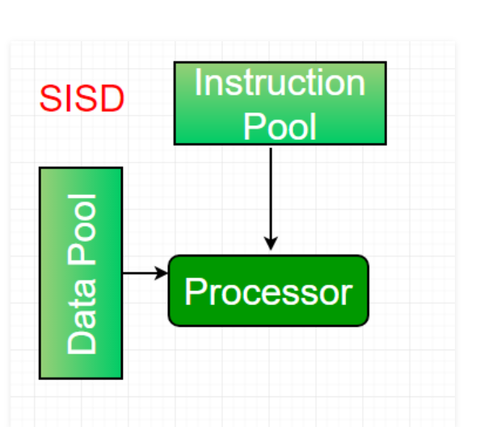
SISD
CU : Control Unit
PU : Processing Unit
MU: Memory Unit
Has 1 Control Unit
Single Instruction Stream
Data is stored in 1 Memory Unit
Von Neumann architecture

Slide 8
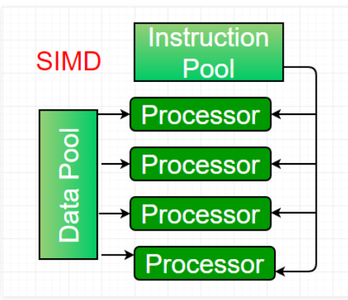
SIMD

Slide 9
SIMD
SIMD architectures can exploit significant data-level parallelism for
Matrix-oriented scientific computing
Media-oriented image and sound processors
SIMD is more energy efficient than MIMD
Only needs to fetch one instruction per data operation
Makes SIMD attractive for personal mobile devices
SIMD allows programmer to continue to think sequetially

Slide 10
SIMD Parallelism
SIMD architecture :
Vector architectures
Multimedia extensions
Graphics processor unit
For x86 processors :
Expect two additional cores per chip per year
SIMD width to double every four years
Potential speedup from SIMD to be twice that from MIMD

Slide 11
Vector architectures
Basic idea:
Read sets of data elements into “vector registers”
Operate on those registers
Disperse the results back into memory
Registers are controlled by compiler
Used to hide memory latency
Leverage memory brandwith

Slide 12
VMIPS
Example architecture: VMIPS
Loosely based on Cray-1
Vector registers
Each register holds a 64-element, 64 bits/element vector
Register file has 16 read ports and 8 write ports
Vector functional units
Fully pipeline
Data and control hazards are detected
Vector load-store unit
Fully pipeline
One word per clock cycle after initial latency
Scalar registers
32 general-purpose registers
32 floating-point registers

Slide 13
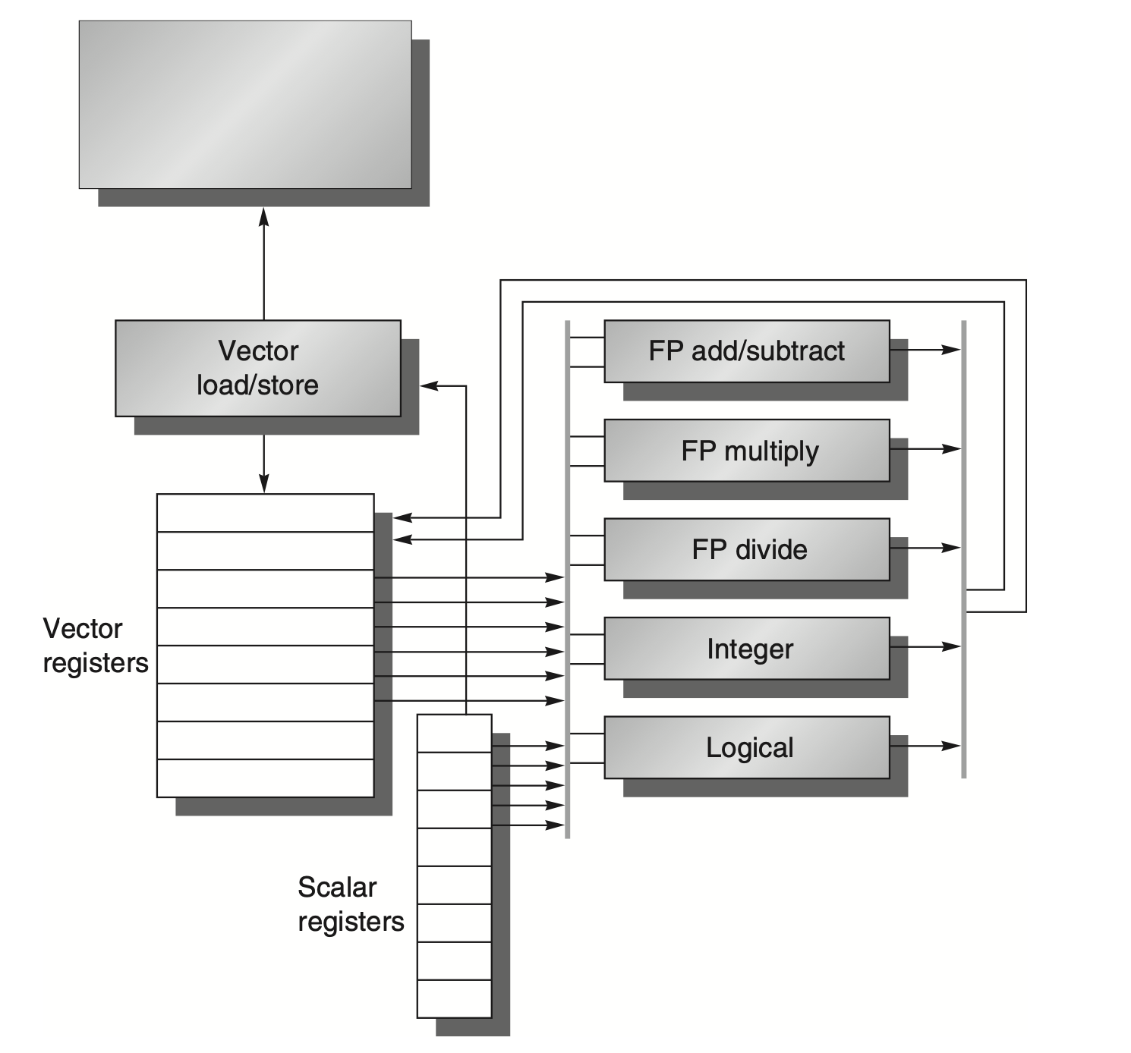
VMIPS

Slide 14
Simd extensions
Media applications operate on data types narrower than the native word size
Example: disconnect carry chains to “partition” adder
Limitations, compared to vector instructions:
Number of data operands encoded into op code
No sophisticated addressing modes(e.g. stride, scatter-gather)
No mask registers

Slide 15
SIMD implementations
Implementations:
Intel MMX (1996)
Eight 8-bit integer ops or four 16-bit integer ops
Streaming SIMD Extensions (SSE) (1999)
Eight 16-bit integer ops
Four 32-bit integer/fp ops or two 64-bit integer/fp ops
Advanced Vector Extensions (AVX) (2010)
Four 64-bit integer/fp ops
256-bit registers
3-operand SIMD instructions
Only works on newest Oss(win7)
Operands must be consecutive and aligned memory locations

Slide 16
Graphical Processing Units
Given the hardware invested to do graphics well, how can we supplement it to improve performance of a wider range of applications?
Basic idea:
Heterogeneous execution model
CPU is the host, GPU is the device
Develop a C-like programming language for GPU
Unify all forms of GPU parallelism as CUDA thread
Programming model is “Single Instruction Multiple Thread”

Slide 17
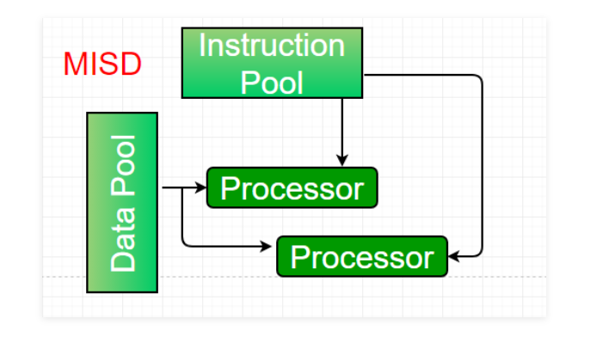
MISD
No commercial multiprocessor of this type has been built to date
But it rounds out this simple classification

Slide 18
MIMD
Each processor fetches its own instructions and operates on it own data
It targets task-level parallelism
MIMD is more flexible than SIMD
MIMD architectures :
Shared Memory
Distributed Memory

Slide 19
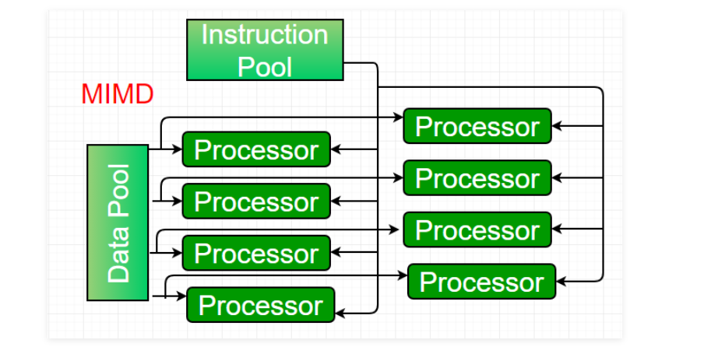
MIMD

Slide 20
Synchonization
2
Lock and Barries

Slide 21
Lock
A lock is a mechanism to ensure mutual exclusion
Two synchronization functions:
Lock(k):
Acquires the lock
If several processes try to acquire the lock, n-1 are kept waiting
If more processes arrive, they are kept to waiting
Unlock(k)
Releases the lock
Allow that a waiting process acquires the lock

Slide 22
Waiting mechanisms
Twi alternatives: busy waiting and blocking
Busy waiting:
Process waits in a loop that constantly queries the wait control variable value
Spin-lock
Blocking:
Process remains suspended and yields processor to other process
If a process executes unlock and there are blocked processes, one of them is un-blocked
Requires support from a scheduler(usually OS or runtime)
Alternative selection depends on cost

Slide 23
Components
Three elements of design in a locking mechanism: acquisition, waiting, and release.
Acquisition method:
Used to try to acquire the lock
Waiting method:
Mechanism to wait until lock can be acquired
Release method:
Mechanism to release one or several waiting processes

Slide 24
Simple locks
Shared variable k with two values.
0 -> open
1 -> closed
Lock(k)
If k=1 -> busy waiting while k=1
If k=0 -> k=1
Do not allow that 2 processes acquire a lock simultaneously
Use read-modify-write to close it

Slide 25
Exponential delay
Goal
Reduce number of memory accesses
Limit energy consumption

Slide 26
Tagged locks
Two counters:
Acquire counter: Number of processes that have requested the lock
Release counter: Number the times the lock has been released
Lock:
Tag -> acquisition counter value
Acquisition counter is incremented
Process remains waiting until the release counter matches the tag
Unlock:
Increments release counter

Slide 27
Queue based locks
Keep a queue with processes waiting to enter into a critical section
Lock:
Check if queue is empty
If a process joins the queue it performs busy waiting in a variable
Each process performs busy waiting in a different variable
Unlock
Removes process from queue
Modifies process waiting control variable

Slide 28
Barriers
A barrier allows to synchronize several processes in some point
Guarantees that no process passes the barrier until all have arrived
Use to synchronize phases in a program

Slide 29
Centralized barriers
Centralized counter associated to the barrier
Counts number of processes that have arrived the barrier
Barrier function:
Increment counter
Waits the counter to reach the number of processes to be synchronized

Slide 30
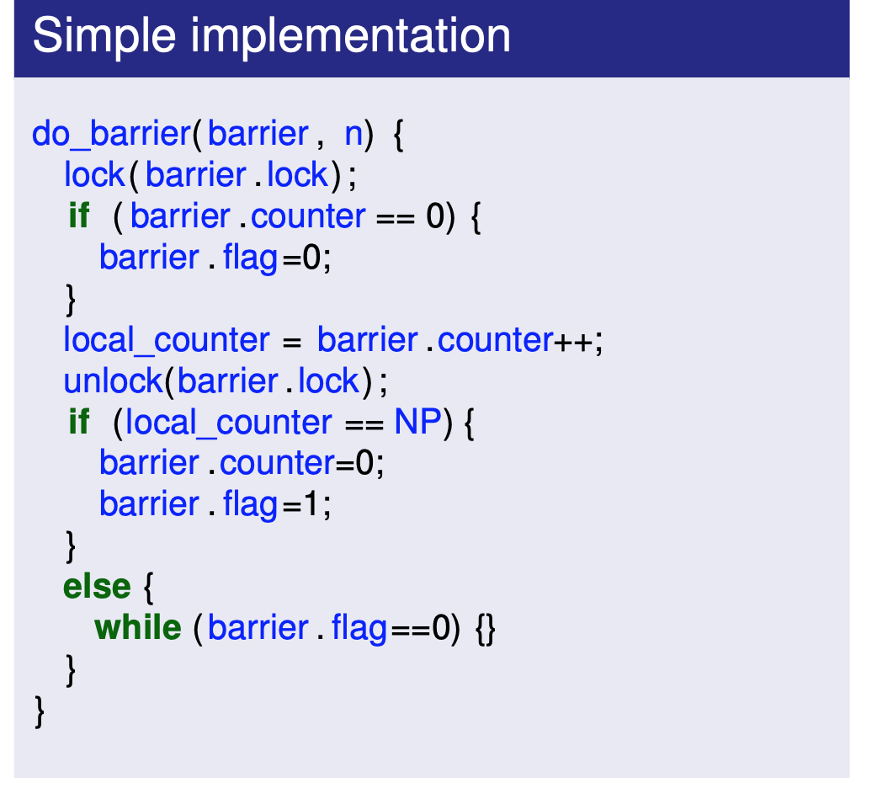
Simple barrier

Slide 31
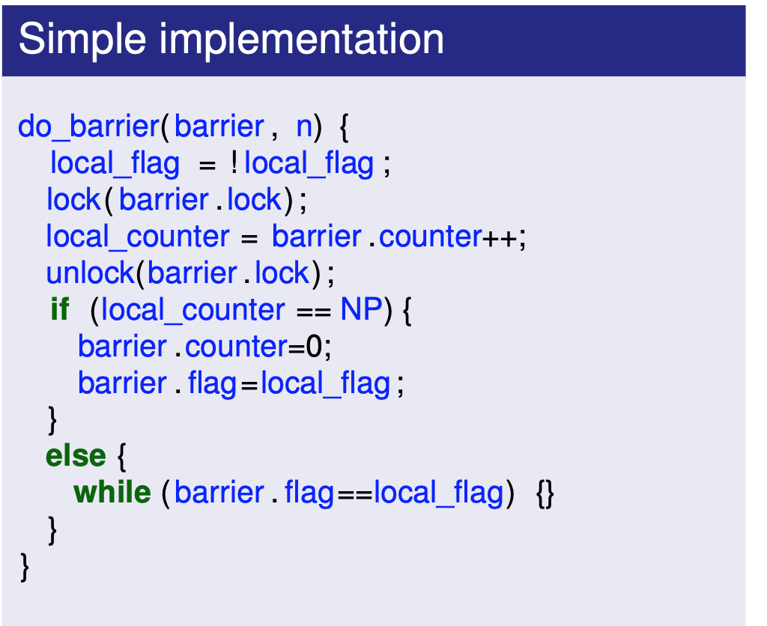
Barrier with way inversion

Slide 32
Tree barriers
A simple implementation of barriers is not scalable
Contention in access to shared variables
Tree structure for process arrival and release
Specially useful in distributed network

Slide 33
Summary
Locks as a mechanism for mutual exclusion
Busy waiting vs blocking
Three design elements: acquisition, waiting and release
Locks may lead to problems if order is not fixed
Solutions based in tags or queues
Barriers offer mechanisms to structure programs in phases

Slide 34
Memory Consistency
2

Slide 35
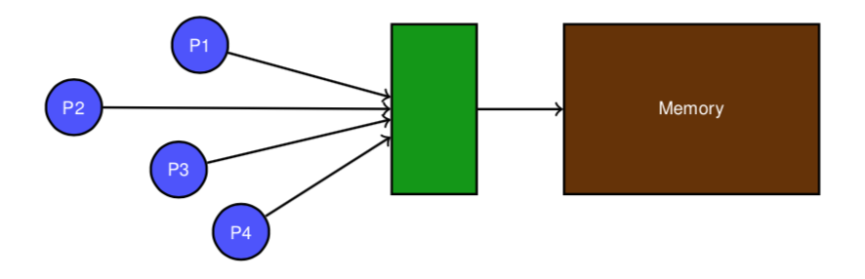
Memory Consistency
Memory consistency model:
Set of rules defining how the memory system processes
memory operations from multiple processors.
Contract between programmer and system.
Determines which optimizations are valid on correct programs.

Slide 36
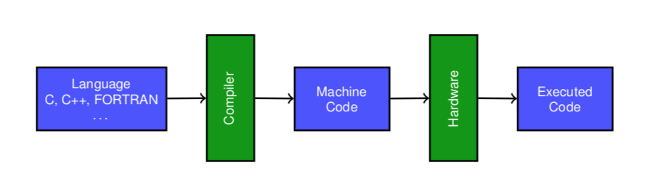
Memory model
Interface between program and its transformers. Defines which values can be returned by a read operation.
The language’s memory model has implications for hardware.

Slide 37
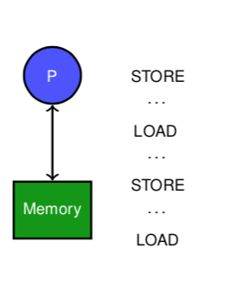
Single processor memory model
Memory behavior model:
Memory operations happen in program order.
A read returns the value from the last write in program order.
Semantics defined by sequential program order:
Simple but constrained reasoning.
Solve data and control dependencies.
Independent operations may be executed in parallel.
Optimizations preserve semantics.

Slide 38
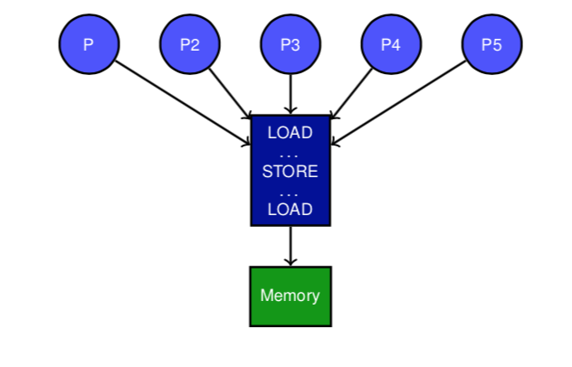
Sequential consistency
A multiprocessor system is sequentially consistent if the result of any execution is the same that would be obtained if operations from all processors were executed in some sequential order, and operations from each individual processor appear in that sequence in the order established by the program.
“Leslie Lamport, 1979 “

Slide 39
Sequential Consistency: Constraints
Program order. Memory operations from a program must be made visible to all processes in program order.
Atomicity.
Total execution order between processes must be consistent requiring that all operations are atomic.
All the operations that a processor does after it has seen the new value of a write are not visible to other processes until they have seen the value from that write.

Slide 40
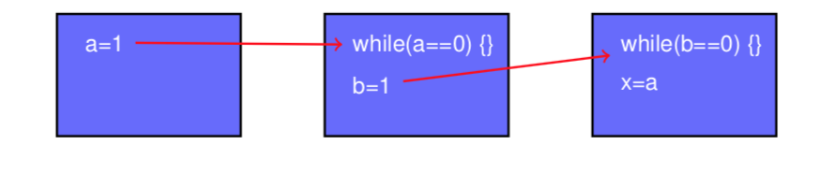
Atomicity
Non atomic writes: Write on b could bypass to while loop and read from a would bypass the write.
X=0.
Atomic writes:
Sequential consistency is preserved.

Slide 41
Sequential consistency
Sequential consistency constraints all memory operations:
Write → Read.
Write → Write.
Read → Read, Read → Write.
Simple model to reason about parallel programs.
But, simple single processor reorderings may violate sequential consistency model:
Hardware reordering to improve performance.
Write buffers, overlapped writes, . . .
Compiler optimizations apply transformations with memory operations reordering.
Scalar replacement, register allocation, instruction scheduling, . . .
Transformations by programmers, or refactoring tools also modify program semantics.
Notes:
Câu hỏi: làm thế nào để chúng ta dung hòa mô hình nhất quán tuần tự với nhu cầu của hiệu suất?

Slide 42
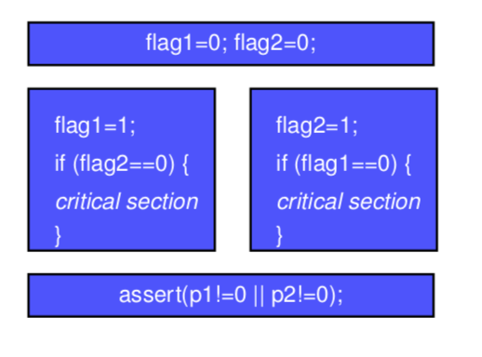
Sequential consistency violation
If caches use a write buffer:
Writes are delayed in buffer.
Reads obtain the old value.
Dekker Algorithm is no longer valid.
Dekker algorithm is the first known solution to the mutual exclusion problem.

Slide 43
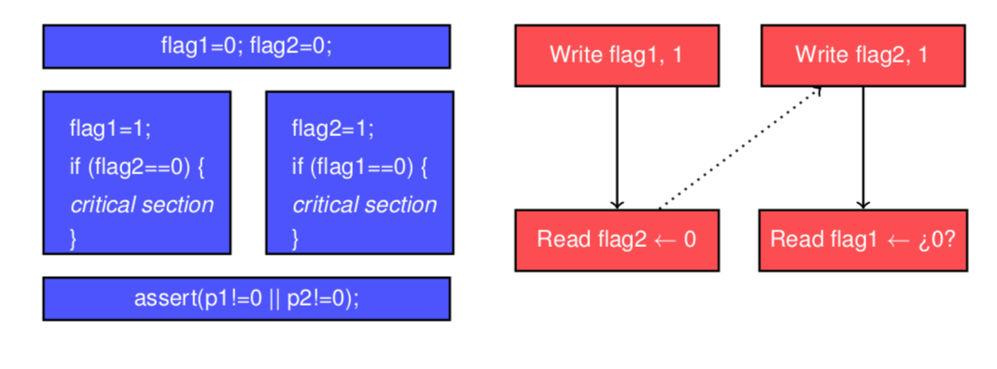
Program order

Slide 44
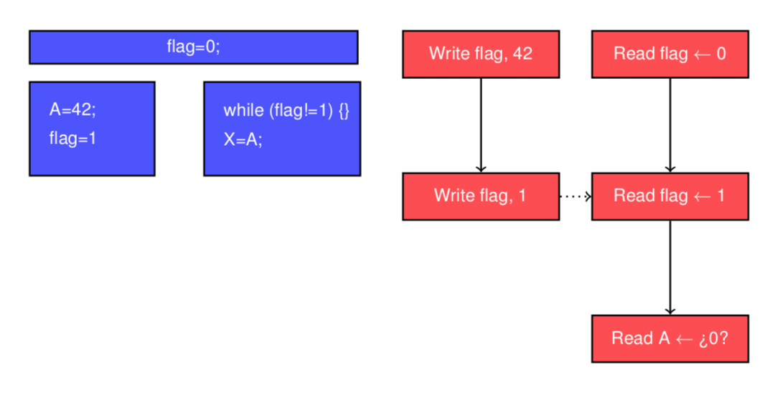
Program order

Slide 45
Conditions for sequential consistency
Sufficient conditions:
Each process issues memory operations in program order.
After issuing a write, the process that performed the issue waits for completions of write before issuing another operation.
After issuing a read, the process that performed the issue waits for completion of read and for completion of the write of the value being read.
Wait for write propagation to all processes.
Very demanding conditions.
There might be necessary conditions that are less demanding.

Slide 46
Classification for Relaxed Models
Typically described as system optimizations
Program order relaxation:
Write => Read
Write => Write
Read => Write, Write -> Write.
Read others’ write early
Read own write early
All models provide safety net
All models maintain uniprocessor data and control dependences, write serialization
Notation: X→Y (Y bypasses X).

Slide 47
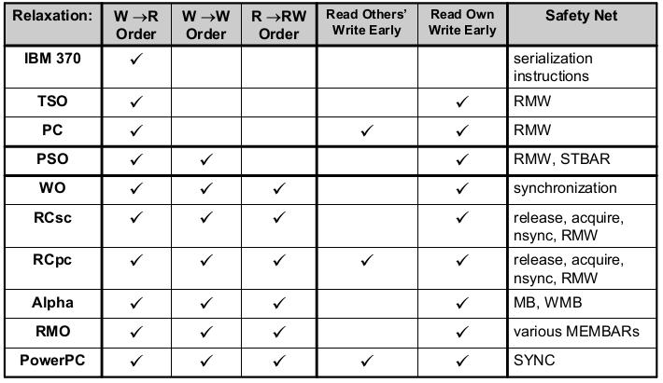
Some Current System-Centric Models

Slide 48
Reads bypass writes (W→R)
A read may execute before a preceding write.
Typical in systems with write buffer.
Check consistency with buffer.
Allow read buffer.

Slide 49
Other models
R → W, W → R. Allow that writes may arrive into memory out of program order.
R → W, W → R, R → R, W → W.
Avoid only data and control dependencies within processor.
Alternatives:
Weak consistency. Release consistency.

Slide 50
Weak ordering
Divides memory operations into data operations and synchronization operations.
Synchronization operations act as a barrier.
1 All preceding data operations in program order to a synchronization must complete before synchronization is executed.
2 All subsequent data operations in program order to a synchronization operation must wait until synchronization ins completed.
3 Synchronization are performed in program order.
Hardware implementation of barrier.
Processor keeps a counter:
Data operation issue ⇒ increment.
Data operation completed ⇒ decrement.

Slide 51
Release/acquire consistency
More relaxed than weak consistency.
Synchronization accesses divided into:
Acquire.
Release.
Semantics:
Acquire : Must complete before all subsequent memory accesses.
Release :
Must complete all previous memory accesses. Subsequent memory accesses MAY initiate. Operations following a release and must wait, must be protected with an acquire.

Slide 52
Summary
Consistency memory model determines which optimizations are valid.
Sequential consistency establishes as constraints atomicity and program order.
More relaxed models than sequential consistency can be used.
Weak consistency.
Release/acquire consistency

Slide 53
What is multi-threading?
2

Slide 54
Outline
Memory Consistency
What is multi-threading?
Types of multithreading?
Fine-grained multithreading
Coarse-grained multithreading
Simultaneous multithreading
Multithreading with Superscalar/ without Superscalar

Slide 55
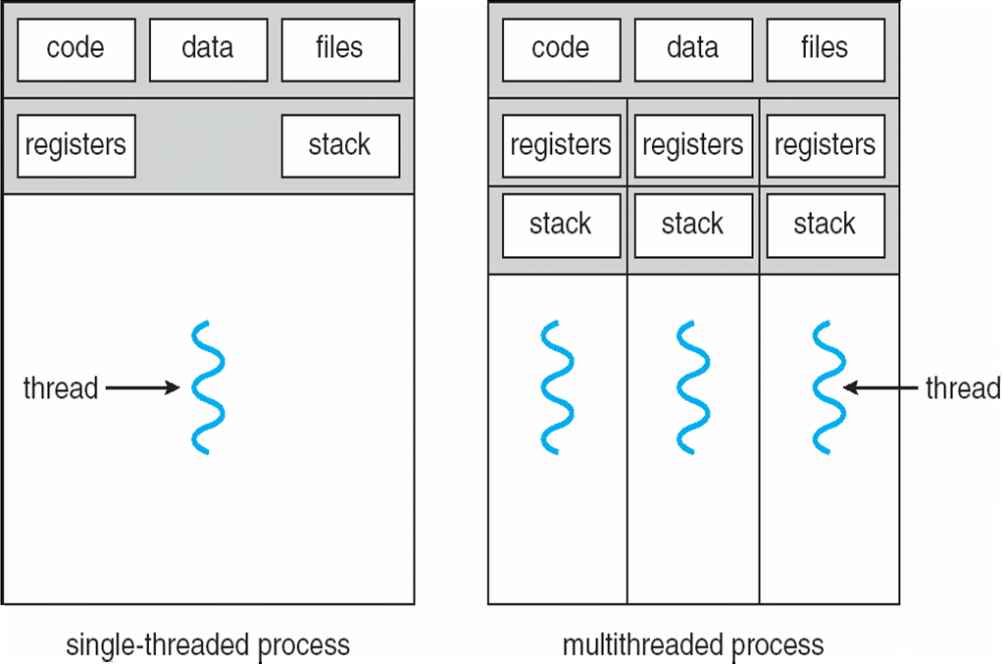
What is a Thread?
A thread: process with own instructions and data – thread may be a process part of a parallel program of multiple processes, or it may be an independent program – Each thread has all the state (instructions, data, PC, register state, and so on) necessary to allow it to execute
Is an independent flow of control
Operates within a process with other threads
Notes:
Thread
Instruction stream with state (registers and memory)
Register state is also called “thread context”
Threads could be part of the same process (program) or from different programs
Threads in the same program share the same address space (shared memory model)

Slide 56
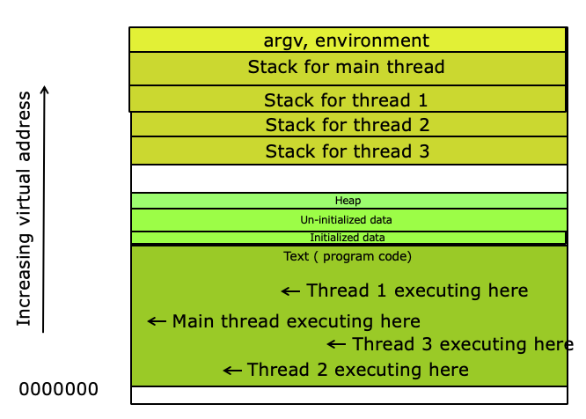
Threads in Memory

Slide 57
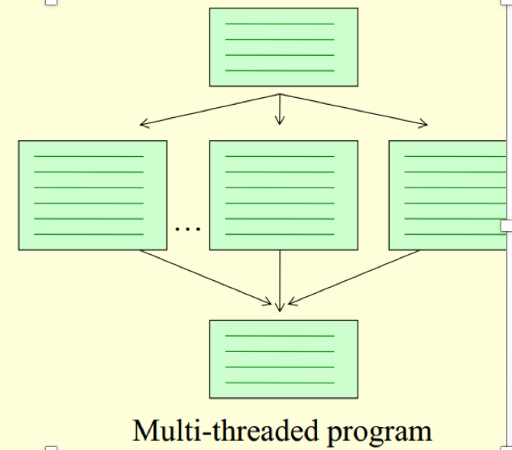
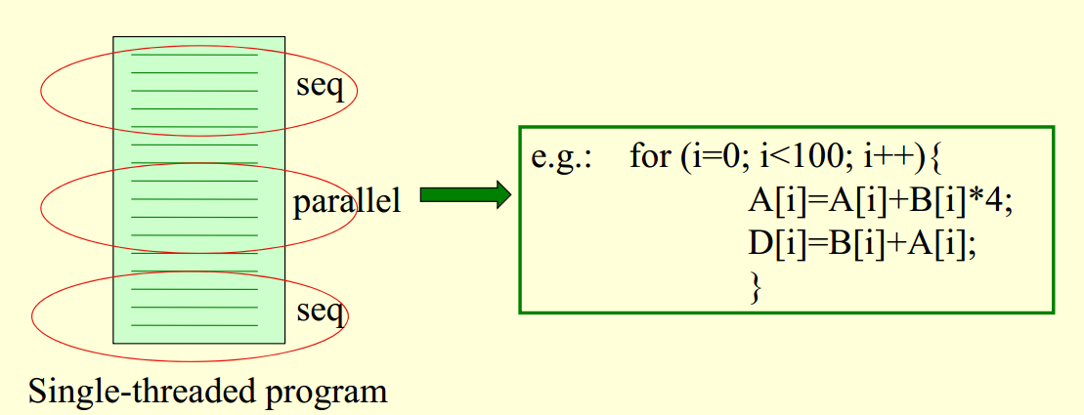
Threads
Independent sequences of instructions

Slide 58
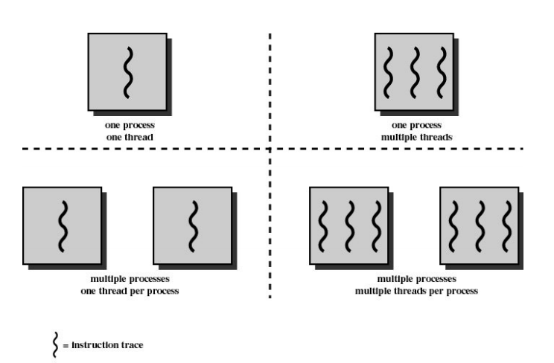
Type process thread
Notes:
Multithreading: more threads share the functional units of the same CPU, overlapping execution;
The operating system sees the single physical processor as a symmetric multiprocessor constituted by two processors
Threads are created by the programmer, or by the OS • Amount of computation assigned to each thread = grain size – Can be from a few instructions (more suited to uniprocessor multithreading: for 1 processor, need n threads) – To hundreds, or thousands of instructions (multiprocessor multithreading: for n processors, need n threads)

Slide 59
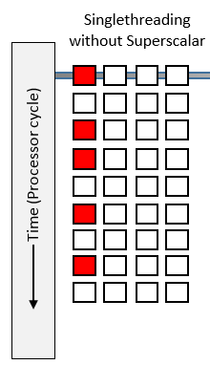
Single threading
Only execute one instruction in a cycle clock.
Waste CPU time for thread locking (wait IO response, fetch data…).

Slide 60
Superscalar
A form of parallelism called instruction-level parallelism within a single processor.
The CPU processes multiple instructions per clock cycle by including parallel Execution Units.

Slide 61
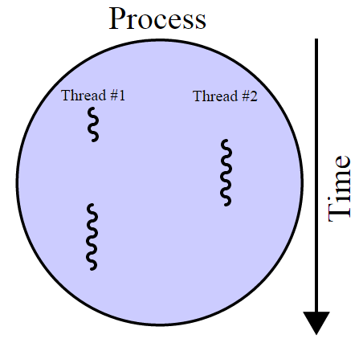
Multithreading
This higher-level parallelism is called thread-level parallelism.
A thread is a separate process with its own instructions and data.
Multithreading: allows multiple threads to share the functional units of a single processor in an overlapping fashion.
Notes:
Multithreading: multiple threads to share the functional units of 1 processor via overlapping
processor must duplicate independent state of each thread e.g., a separate copy of register file, a separate PC, and for running independent programs, a separate page tabl
memory shared through the virtual memory mechanisms, which already support multiple processesHW for fast thread switch; much faster than full process switch ≈ 100s to 1000s of clocks
When switch?
Alternate instruction per thread (fine grain)
When a thread is stalled, perhaps for a cache miss, another thread can be executed (coarse grain)

Slide 62
Multithreading
What additional HW is needed in a multithreaded processor
• The processor switches between different threads when one stalls, another goes into execution
The state of each thread must therefore be preserved while the processor switches • Need multiple Register Files and multiple PCs (Program Counter registers) • Other parts, such as for example the functional units, are not duplicated
Notes:
Multithreading: multiple threads to share the functional units of 1 processor via overlapping
processor must duplicate independent state of each thread e.g., a separate copy of register file, a separate PC, and for running independent programs, a separate page tabl
memory shared through the virtual memory mechanisms, which already support multiple processes HW for fast thread switch; much faster than full process switch ≈ 100s to 1000s of clocks
When switch?
Alternate instruction per thread (fine grain)
When a thread is stalled, perhaps for a cache miss, another thread can be executed (coarse grain)
Multitasking: When a new thread needs to be executed, old thread’s context in hardware written back to memory and new thread’s context loaded

Slide 63
Multithreading
Advantages:
If a thread gets a lot of cache misses, the other thread can continue.
If a thread cannot use all the computing resources of the CPU, running another thread can avoid.
Share same set of data.
Disadvantages:
Multiple threads can interfere with each other when sharing hardware resources.
Need thread-switching hardware and cost.

Slide 64
Types of Multithreading
Fine-grained
Cycle by cycle
Switches between threads on each instruction
Hide the throughput losses that arise from both short and long stalls.
Coarse-grained
Switches threads only on costly stalls, such as level 2 cache misses
Switch on quantum/timeout
Throughput losses from shorter stalls
Simultaneous
Instructions from multiple threads executed concurrently in the same cycle

Slide 65
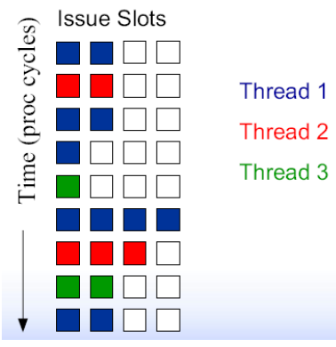
Fine-grained multithreading
Fine grained multithreading:
Switches from one thread to the other at each instruction – the execution of more threads is interleaved (often the switching is performed taking turns, skipping one thread if there is a stall)
The CPU must be able to change thread at every clock cycle. It is necessary to duplicated the hardware resources.
Notes:
Cycle by cycle
Chuyển đổi từ luồng này sang luồng khác trong mỗi lệnh - việc thực hiện nhiều luồng hơn được xen kẽ (thường việc chuyển đổi được thực hiện theo lượt, bỏ qua một luồng nếu có stall)
Idea: Switch to another thread every cycle such that no two instructions from the thread are in the pipeline concurrently

Slide 66

Fine-grained multithreading
(Extremely) Fine-Grain Multithreading (FGMT) • Key idea: have so many threads that never stall on cache misses • If miss latency is N cycles, have N threads! • Thread scheduling policy • Switch threads every cycle (round-robin) – Need a lot of threads • Many threads ! many register files – Sacrifices significant single thread performance + Tolerates latencies (e.g., cache misses) + No bypassing needed! • Pipeline partitioning • Dynamic, no flushing • Extreme example: Denelcor HEP, Tera MTA • So many threads (100+), it didn’t even need caches • Failed commercially, but good for certain niche apps

Slide 67
Fine-grained multithreading
Advantage is it can hide both short and long stalls, since instructions from other threads executed when one thread stalls
Disadvantage is it slows down execution of individual threads, since a thread ready to execute without stalls will be delayed by instructions from other threads

Slide 68
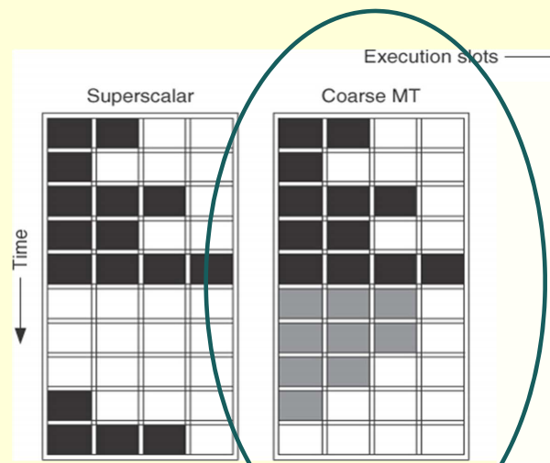
Coarse grained multithreading
Switching from one thread to another occurs only when there are long stalls – e.g., for a miss on the L2 cache, Function unit data hazard, .
Two threads share many system resources (e.g., architectural registers) -> the switching from one thread to the next requires different clock cycles to save the context.
Example: IBM RS64-IV (Northstar), 2 contexts
Notes:
Idea: When a thread is stalled due to some event, switch to a different hardware context
Switch-on-event multithreading
Possible stall events
Cache misses
Synchronization events (e.g., load an empty location)
FP operations

Slide 69
Coarse grained multithreading
Advantage:
in normal conditions the single thread is not slowed down;
Relieves need to have very fast thread-switching
Doesn’t slow down thread, since instructions from other threads issued only when the thread encounters a costly stall
Disadvantage:
For short stalls it does not reduce the throughput loss
the CPU starts the execution of instructions that belonged to a single thread, when there is one stall it is necessary to empty the pipeline before starting the new thread.
Because of this start-up overhead, coarse-grained multithreading is better for reducing penalty of high cost stalls, where pipeline refill << stall time

Slide 70
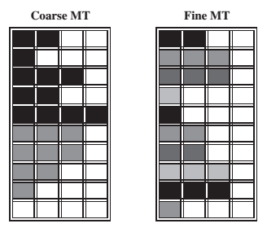
Multithreading with Superscalar
Using the issue slots of a superscalar processor in two approaches
CPU have many execution unit or other (GPU).
Separate process into many thread so that multithreading parallel in many execution unit.

Slide 71
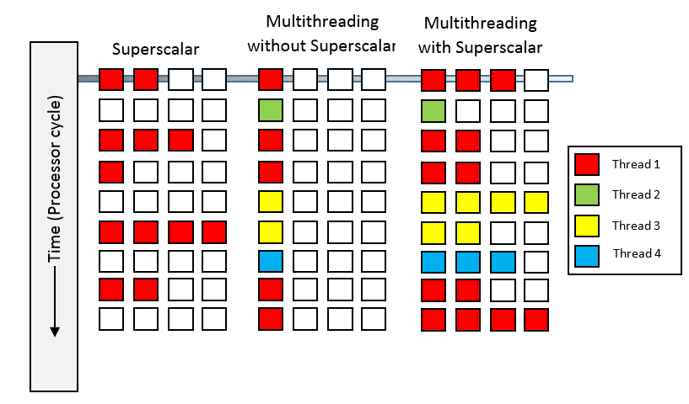
Multithreading and Superscalar

Slide 72
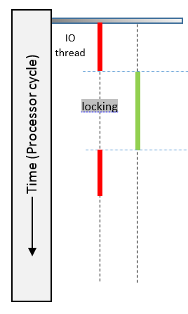
Multithreading without Superscalar
IO task offen a long time for response.
Multithreading for responsiveness: create a background thread to execute heavy IO tasks or heavy computation tasks so that the user can continue their work, without having to wait for the hard drive to finish its task.

Slide 73
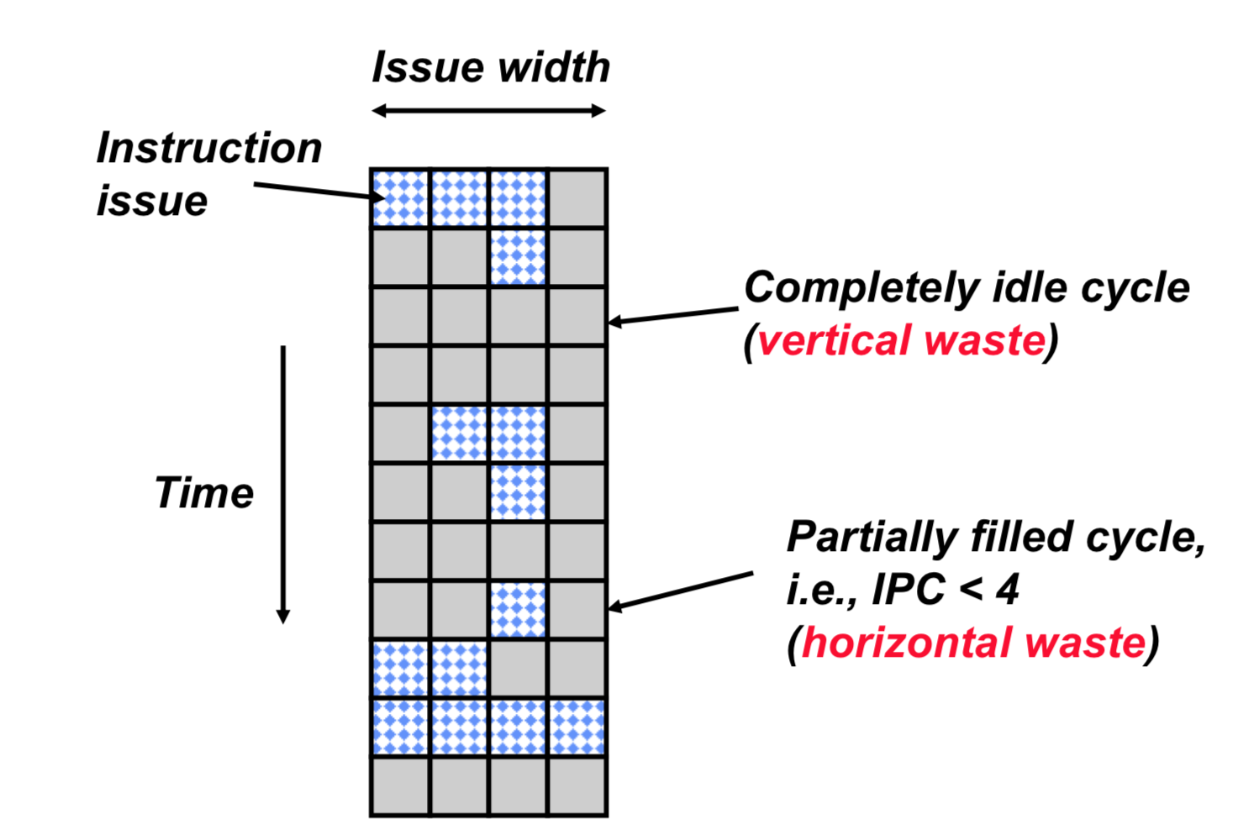
Superscalar Machine Efficiency
Why horizontal waste? • Why vertical waste?

Slide 74
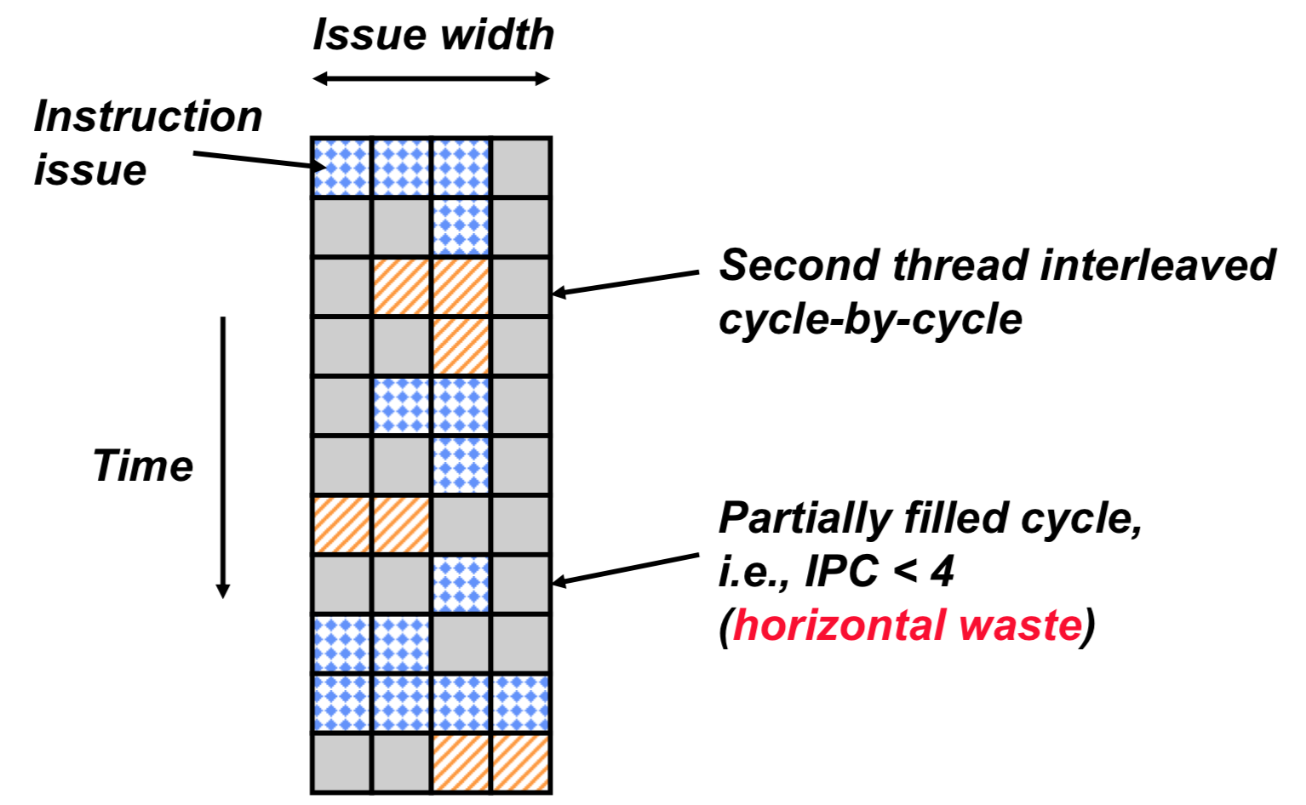
Vertical Multithreading
What is the effect of cycle-by-cycle interleaving?
– removes vertical waste, but leaves some horizontal waste

Slide 75
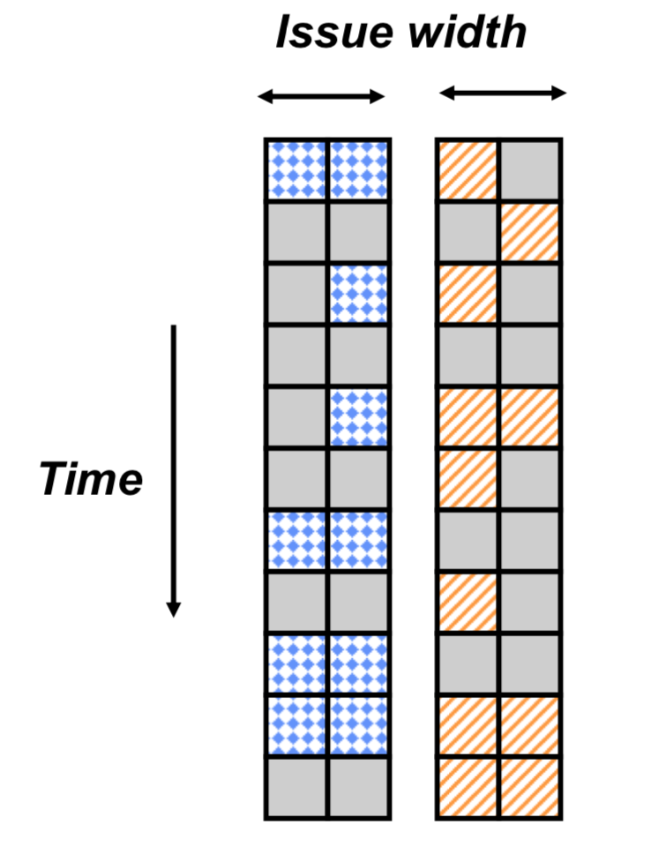
Chip Multiprocessing
What is the effect of splitting into multiple processors?
– eliminates horizontal waste, – leaves some vertical waste, and – caps peak throughput of each thread.

Slide 76
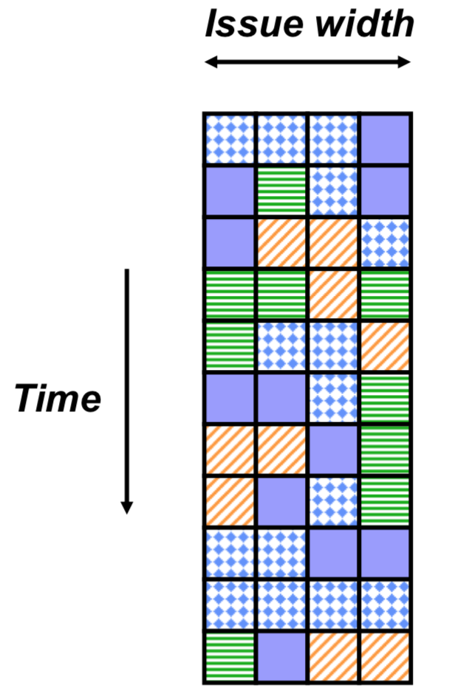
Ideal Superscalar Multithreading
Interleave multiple threads to multiple issue slots with no restrictions

Slide 77
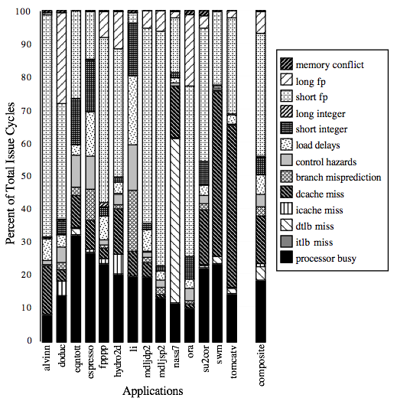
Most execution units in superscalar are idle
For an 8-way superscalar.
observation
Tullsen, Eggers, and Levy,
“Simultaneous Multithreading:

Slide 78
Thread level parallelism: simultaneous multithreading
Uses the resources of one superscalar processor to exploit simultaneously ILP and TLP.
Key motivation: a CPU today has more functional resources than what one thread can in fact use
Thanks to register renaming and dynamic scheduling, more independent instructions to different threads may be issued without worrying about dependences (that are solved by the hardware of the dynamic scheduling).
Simultaneously schedule instructions for execution from all threads

Slide 79
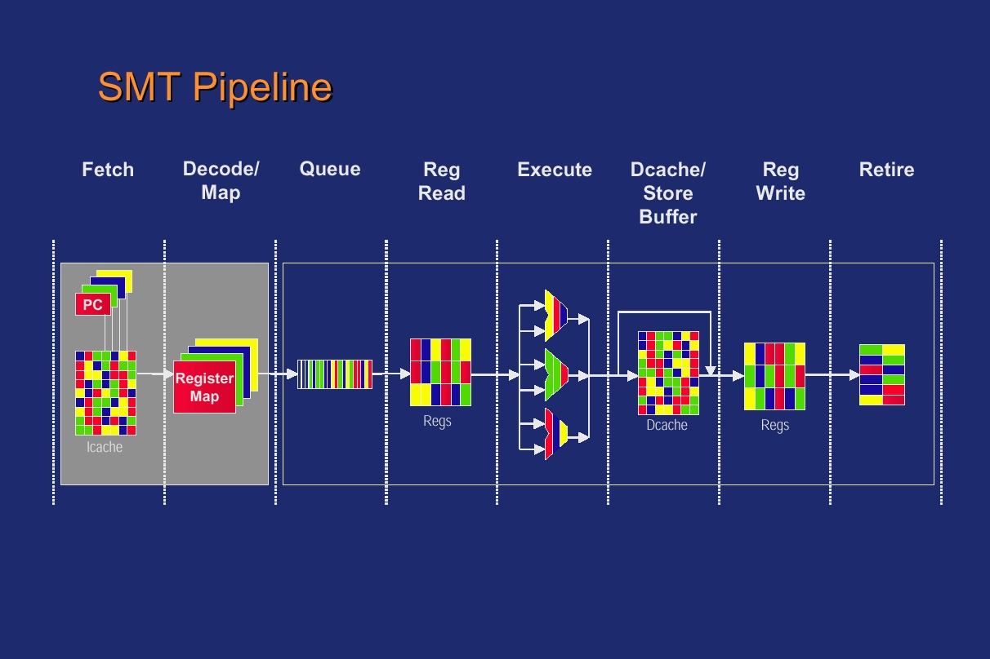
SMT Microarchitecture

Slide 80
Simultaneous Multithreading (SMT)
simultaneous multithreading (SMT): insight that dynamically scheduled processor already has many HW mechanisms to support multithreading
Large set of virtual registers that can be used to hold the register sets of independent threads
Register renaming provides unique register identifiers, so instructions from multiple threads can be mixed in data path without confusing sources and destinations across threads
Out-of-order completion allows the threads to execute out of order, and get better utilization of the HW
Just adding a per thread renaming table and keeping separate PCs
Independent commitment can be supported by logically keeping a separate reorder buffer for each thread
Notes:
đồng thời đa luồng

Slide 81
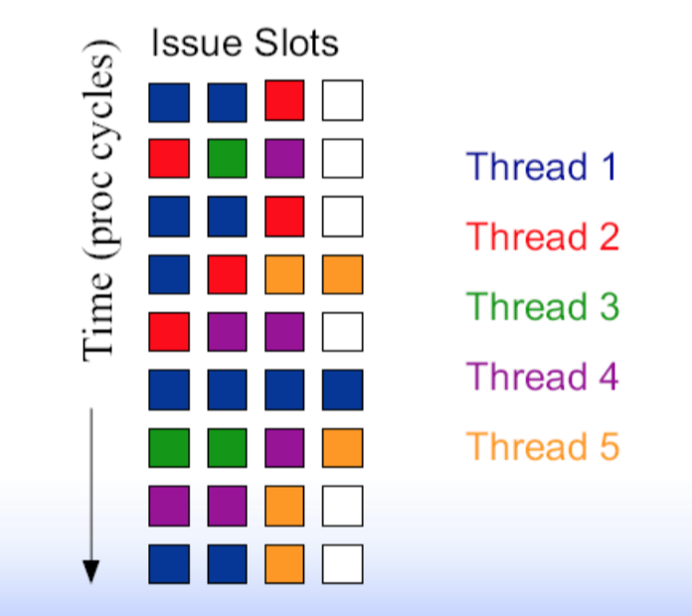
Goals for an SMT architecture implementation
The system can be dynamically adapted to the environment, allowing (if possible) the execution of instructions from each thread, and allowing that the instructions of a single thread used all functional units if the other thread incurs in a long latency event.
More threads use the issues possibilities of the CPU at each cycle; ideally, the exploitation of the issues availabilities is limited only by the unbalance between resources requests and availabilities.
Notes:
Hệ thống có thể được điều chỉnh linh hoạt với môi trường, cho phép (nếu có thể) thực hiện các lệnh từ mỗi luồng và cho phép các lệnh của một luồng sử dụng tất cả các đơn vị chức năng nếu luồng khác phát sinh trong một sự kiện có độ trễ dài.
Nhiều luồng sử dụng các khả năng vấn đề của CPU ở mỗi chu kỳ; lý tưởng nhất là việc khai thác các vấn đề có sẵn chỉ bị giới hạn bởi sự mất cân bằng giữa các yêu cầu tài nguyên và tính khả dụng.

Slide 82
Goals for an SMT architecture implementation
Minimize the architectural impact on conventional superscalar design
Minimize the performance impact on a single thread
Achieve significant throughput gains with many threads

Slide 83
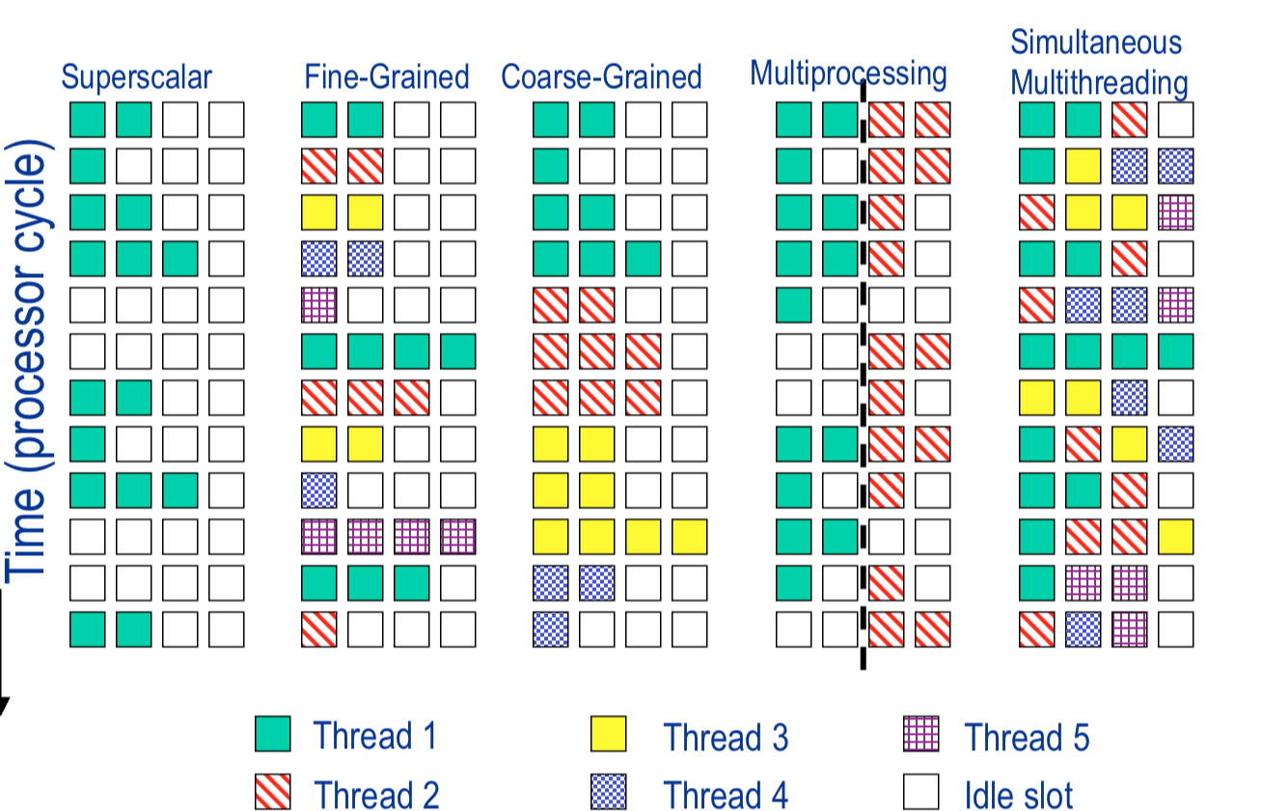
Multithreading Summary
Notes:
Superscalar processor has high under-utilization – not enough work every
cycle, especially when there is a cache miss
Fine-grained multithreading can only issue instructions from a single thread
in a cycle – can not find max work every cycle, but cache misses can be tolerated
Simultaneous multithreading can issue instructions from any thread every
cycle – has the highest probability of finding work for every issue slot
Goal: increase throughput
Not latency
Utilize execution resources by sharing among multiple threads:
Fine-grained, coarse-grained, simultaneous
Usually some hybrid of fine-grained and SMT
Front-end is FG, core is SMT, back-end is FG
Resource sharing

Slide 84
Multithreading Summary
Goal: increase throughput
Not latency
Utilize execution resources by sharing among multiple threads:
Fine-grained, coarse-grained, simultaneous
Usually some hybrid of fine-grained and SMT
Front-end is FG, core is SMT, back-end is FG
Resource sharing

Slide 85
Reading Assignment 2
2

Slide 86
Superpipeline, Superscalar, VLIW
Nhóm 1
1870583 Chu XuânTình
1870584 Trần ThànhĐạt
1870387 Lê vănDuẫn
1970017 PHAN VĂN HƯNG
1670967 NGUYỄN NGỌC THÀNH
1970133 TRẦN QUỐC TRÍ

Slide 87
Introduction - Overview
In general, the performance of a microprocessor is expressed by equation (1):
Execution_Time = IC × CPI × clock_cycle_time (1)
In a basic pipeline architecture, only one instruction can be issued at each cycle. Overcoming this limitation has been the subject of much work in the past: more specifically, it has been the goal of computer architects to reduce each variable of equation (1).
CPI can be improved by designing more advanced organizations and architectures and also by modifying the instruction set architecture.
clock_cycle_time can be improved by better process technology, advanced hardware implementation techniques, and also by more sophisticated architectural organizations.
IC can be improved by implementing advanced compiler and instruction set architectures.

Slide 88
Introduction - Overview
The three main techniques mentioned earlier are such improvements to the architecture.
Superpipeline improves the performance by dividing the long latency stages (such as the memory access stages) of a pipeline into several shorter stages, thereby reducing the clock rate of the pipeline. Superpipeline has the effect of reducing clock cycle time in equation (1).
Superscalar, on the other hand, improves the performance by dynamically issuing multiple instructions per cycle (this means that superscalar reduces CPI).
VLIW (Very Long Instruction Word) improves the performance by utilizing the compiler to combine several instructions into one very long instruction and executing it. (VLIW reduces IC ).

Slide 89
1.Superpipeline

Slide 90
1.Superpipeline
Superpipeline simply allows a processor to improve its performance by running the pipeline at a higher clock rate. The higher clock rate is achieved by identifying the pipeline stages that determine the clock cycle (in other words, the most time consuming stages) and decomposing them into smaller stages.
Superpipeline is the simplest technique of the three. It does not require additional hardware (such as functional units and fetch units) that a superscalar architecture does. It also does not require the complex controls (no multiple issue control or need to keep track of the instructions issued). Finally, it should be noted that Superpipeline does not need the advanced compiler technologies required by the VLIW model.

Slide 91
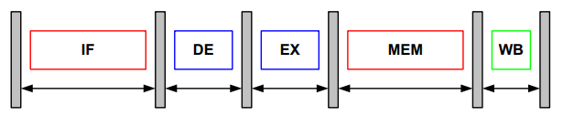
1.1.Concepts and Benefits
In this figure, each stage is drawn with a white box (with the corresponding name inside) while the gray skinny sticks represent the latches between the stages. The length of the double arrows represent the length of time required by each stage for completion of its task.
Either the IF (Instruction Fetch) stage or the MEM (Data memory access) stage determine the clock rate because they are the longest time consuming stages of the pipeline (assume for the moment that the IF and MEM stages are nearly twice as long as the other stages).
Figure 1

Slide 92
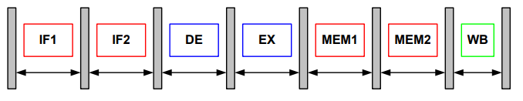
1.1.Concepts and Benefits
We can increase the performance of the pipeline in Figure 1 by dividing the IF and the MEM stages into two halves. This allows the clock_cycle_time of equation (1) to be reduced (by half). This is the key point about superpipeline. (Organizing a pipeline with stages that have approximately the equal amount of execution time.)
Figure 2

Slide 93
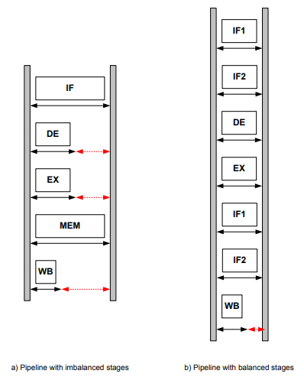
1.1.Concepts and Benefits
This reduced clock rate improves the performance. This is because the clock cycle for the pipeline is determined by the longest stage and as in Figure 3, if the pipeline has few long stages and the rest are nominal compared to the longer ones, there are wasted time when executing the shorter stages. Thus, if there are hundreds and thousands of instructions in a program, the aggregated wasted time will be significant (this wasted time is denoted with dotted lines in Figure 3-(a)). On the other hand, if the pipeline was superpipelined with discrete design principles as it was in Figure 2, most of the stages will be balanced and the wasted time will be minimal as in Figure 3-(b).
Figure 3

Slide 94
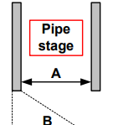
1.2.Design Challenges
It can be observed from Figure 4 that a pipeline stage can be meaningfully pipelined only if the stage between two latches executes in more time (A) than one latch (B)
The time delay of a latch is about one or two order of magnitude shorter compared to the delay of the longest pipeline stage. Otherwise, we just spend more time on additional latches for longer pipelines.
There are more pipeline stages and thus more latches to control
Figure 4

Slide 95
1.2.Design Challenges
Superpipeline also brings a number of major side effects. As the number of stages is increased, so is the number of forwarding paths (stages) and the delay (stall cycles) caused by branches and loads. The combination of the above two factors has strong adverse affects on the performance of the processor since it increases the CPI (therefore, techniques to improve CPI, such as hardware-based pipeline scheduling, branch prediction, multiple issue, and compiler-assisted parallelism exploiting techniques have been developed).
These topics will be discussed in the context of superscalar and VLIW. However, it should be noted that when the above techniques are considered, superpipelining can improve CPI as well.)

Slide 96
1.3.Example Architectures: MIPS R4000
The MIPS R4000 is a superpipelined version of the MIPS R3000 which implemented only a 5 stages pipeline whereas the MIPS R4000 had 8 stages.
The MIPS R4000 operates at double the speed (100 MHz) of the MIPS R3000.
The MIPS R4000 has a branch delay of three cycles and a load delay of two cycles.
The MIPS R3000 had IF (Instruction Fetch), RF (Register Read), ALU (Add, logical, shift computation), DC (Data cache Access and tag check), and WB (Register File write) stages.

Slide 97
1.3.Example Architectures: MIPS R4000
The eight stages of R4000:
IF - Instruction Fetch, First Half: instruction address is selected and the instruction started to be fetch from the instruction cache
IS - Instruction Fetch, Second Half: completes the instruction fetch and the translation of the address
RF - Register Fetch: the instruction is decoded and checked for interlock(slip or stall) condition
EX - Execution Instruction Fetch
DF - Data Fetch, First Half: starts to fetch data from the data cache
DS - Data Fetch, Second Half: completes the cache fetch and align the data
TC - Tag Check: check between the physical address in the TLB(translation lookaside buffer) and the cache tag to determine if there was a hit or miss.
WB - Write Back

Slide 98
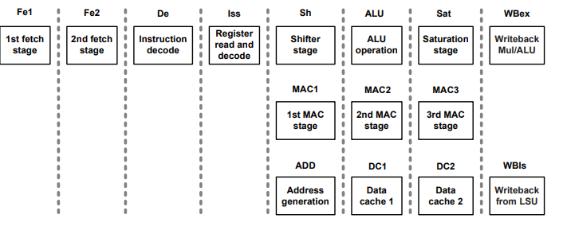
1.3.Example Architectures: The ARM11 Processor
ARM11 processor is based on the ARM architecture v6.
he ARM11 is a highperformance and low-power processor which is equipped with eight stage pipelining. The core consists of two fetch stages, one decode stage, one issue stage, and four stages for the integer pipeline. The eight stages of the ARM11 core are depicted in Figure 5.
Figure 5.​

Slide 99
1.3.Example Architectures: The ARM11 Processor
The function of each of the eight stages:
Fe1 - Instruction Fetch, First Half, Branch Prediction
Fe2 - Instruction Fetch, Second Half, Branch Prediction
De - Instruction Decode
Iss - Register read and instruction issue
Sh - Shifter stage
ALU - Main integer operation calculation
Sat - Pipeline stage to enable saturation of integer results
WBex - Write Back of data from the multiply or main execution pipelines
MAC1 - First stage of the multiply-accumulate pipeline
MAC2 - Second stage of the multiply-accumulate pipeline
MAC3 - Third stage of the multiply-accumulate pipeline
ADD - Address generation stage
DC1 - First stage of Data Cache access
DC2 - Second stage of Data Cache access
WBIs - Write back of data from the Load Store Unit

Slide 100
1.3.Example Architectures: The ARM11 Processor
By overlapping the various stages of operation, the MP11 CPU maximizes the clock rate achievable to execute each instruction. It delivers a throughput approaching one instruction for each cycle.
The Fetch stages can hold up to four instructions, where branch prediction is performed on instructions ahead of execution of earlier instructions.
The Issue and Decode stages can contain any instruction in parallel with a predicted branch.
The Execute, Memory, and Write stages can contain a predicted branch, an ALU or multiply instruction, a load/store multiple instruction, and a coprocessor instruction in parallel execution.

Slide 101
2.Superscalar

Slide 102
2.1.Concept and Benefits
Superscalar architectures are strongly based on previous pipelined RISC processors. The most significant advantage of RISC processors is the inherent simplicity of the instruction set architecture.
The early pipelined RISC processors were designed to execute one instructions for one pipeline stage. The major innovation of the superscalar architecture over the traditional pipelined processor is the multiple instruction issue advantage through dynamic instruction scheduling. In those approaches, each pipeline stage can handle multiple instructions simultaneously. Although the early superscalar architectures were designed to issue multiple instructions in an in-order fashion, this would consequently require out-of-order issue to maximize the effect of the multiple instruction issue feature. Together with the dynamic scheduling and enough backward compatibility, the multiple issue characteristic becomes the main advantage of the current superscalar processors.

Slide 103
2.1.Concept and Benefits
The basic working mechanism of dynamic scheduling is quite simple. The instructions are simply fetched in the instruction sequence. They are then stored in a pool of instructions (also referred to as the scheduling window, instruction window or instruction buffer). Just as in the basic RISC architecture, the instructions are fetched sequentially following the program counter (PC). However, once the instructions are decoded, the dependencies among the instructions are analyzed. Then, the processor can deduce which instructions inside the pool can be executed without causing data hazards. Concurrent execution or out-of-order execution is made possible by hardware-based run-time dependency checking.

Slide 104
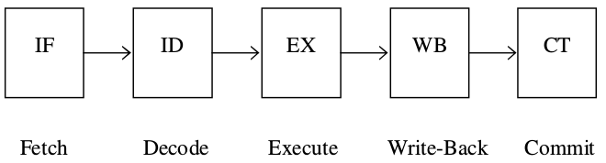
2.1.a. A Basic Model of Superscalar Pipeline
Figure 7 shows a typical model of a basic five-stage pipelined processor. In the single instruction issue RISC processor model, each stage handles only one instruction per cycle. In addition, the execution of the instructions should be made in-order, following the fetching sequence of the original binary code. On the contrary, each of the processing stage is able to handle a number of instructions in the superscalar pipeline model. For example, the IF (Instruction Fetch) stage can fetch multiple instructions from the instruction cache and the EX (Execution) stage can execute multiple instructions simultaneously. This multiple instruction issue characteristic inherently means out-of-order execution of the instruction sequence. It has been developed to reduce the execution time of a fixed size of code by exploiting fine-grain parallelism as low as at the instruction level.
Figure 7

Slide 105
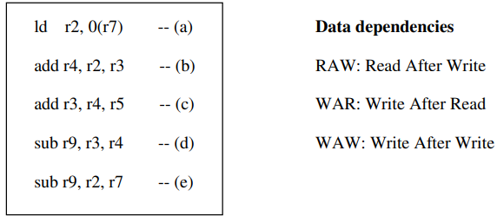
2.1.a. A Basic Model of Superscalar Pipeline
However, executing multiple instructions simultaneously means the sequential characteristic of the original code cannot be guaranteed. This brings out highly critical problems since the current programming languages are strongly based on a sequential programming model, and the binary code is correctly executed only if its sequential characteristic is respected. An inappropriate execution order between instructions could cause data hazards due to the register naming dependencies. Figure 8 depicts possible data hazards due to an out-of-order execution.
Figure 8

Slide 106
2.1.a. A Basic Model of Superscalar Pipeline
The instruction stream on the left side of Figure 8 shows an example of a sequential instruction stream. In the previous pipelined RISC processor model, those instructions are fetched, executed, and committed in program order. This means that none of the instructions can be executed before any instruction ahead of it is committed. However, in the superscalar model, the processor aims at executing in a cycle as many instructions as possible through multiple instruction issue and out-of-order execution (within the allowed bandwidth).
Now, can the five instructions in Figure 8 be executed simultaneously? Obviously, executing those five instructions in parallel without considering the program order does not produce correct results. Indeed, there are some data dependencies.

Slide 107
2.1.b. Dynamic Scheduling of Superscalar
Superscalar architectures achieve dynamic instruction scheduling by using a scheduling window. In dynamic scheduling, the instructions are still fetched sequentially in program order. However, those instructions are decoded and stored in a scheduling window of a processor execution core. After decoding the instructions, the processor core obtains the dependency information between the instructions and can also identify the instructions which are ready for execution (ready instructions mean the instructions of which the source registers have been calculated). Indeed, there must be no data hazard in issuing the ready instructions.
In essence, the execution of an instruction i is decided by the previous instruction k which produces the value for the source registers of the instruction i. This means that the superscalar processors can execute the instructions as soon as the input values are available (also, the corresponding functional units should be available). The processor dynamically achieves parallel execution of the instructions by performing a run-time dependency check and waking up the following instructions.

Slide 108
2.1.b. Dynamic Scheduling of Superscalar
However, at the same time, it also implies that every instruction should broadcast the register name and value across the issue window to wake up and select any ready instruction. This means that a superscalar architecture needs a complex wake-up and selection logic inside of the scheduling window. It should be also noted that a superscalar architecture is expected to deliver high degrees of InstructionLevel Parallelism, together with a large issue width which consequently requires more complex hardwired instruction scheduling logic. This will cause a significant overhead for future superscalar processors.
Although superscalar architectures require complex issue logic and scheduling mechanisms, they have been the standard general-purpose processor during the last decade. This is mostly due to the fact that this model possesses an inherent backward compatibility. This adaptability to legacy code and the ability to continue using conventional compilers make superscalar architectures quite attractive. That is the main reason why all major processor venders have focused on developing superscalar-styled ILP processors since the 1990s.

Slide 109
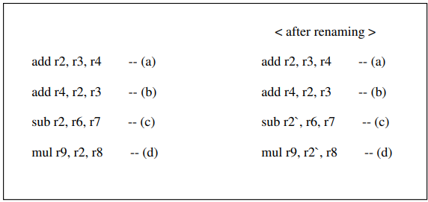
2.1.c.Register Renaming
Register renaming is a technique which increases the chance to uncover independent instructions by removing the false dependencies. Those false dependencies are caused by using the same register name. More specifically, the register renaming can eliminate the WAW (write after write) and WAR (write after read) dependencies among the instructions.
This technique requires a register mapping table. The second method uses a reorder buffer (ROB). In this approach, each entry of reorder buffer works as a physical register.
Figure 9 shows one such example.

Slide 110
2.1.d.Reorder Buffer
A Reorder buffer (ROB) provides two main functions in modern superscalar processor. The first task is to guarantee the in-order completion of a sequential instruction stream. Especially, the in-order completion is crucial for correct speculative execution and the implementation of precise interrupts [34]. As seen in Figure 7, a basic superscalar processor has two stages for instruction completion: the Write Back (WB) stage and the Commit (CT) stage. The WB stage allows the later instructions to use the result of the instruction. However, it does not allow the instruction to write the value into the register file or memory. The instruction still has to wait inside the ROB until it retires from the CT stage. The retire process in the CT stage strictly follows the program order (in-order completion). This in-order completion guarantees that the program can return to the precise state in any point of the program execution. The precise state means the sequentiality of the program execution is guaranteed. This is extremely important for interrupt or miss-speculation cases.

Slide 111
2.1.d.Reorder Buffer
The ROB is implemented as a circular FIFO and retires the instructions following the program order; each entry of the ROB is assigned at the decoding stage and must hold the original program order. During the commit stage, the instructions at the head of the ROB are scanned and an instruction is committed if all the previous instructions are committed (multiple instructions within the commit-width can also be committed during the same cycle).
The second function of the ROB is to achieve register renaming through the slots of the ROB. When the processor uses an ROB, an available entry in the ROB is assigned to an instruction at the decoding stage. Each entry of the ROB contains three fields which indicate the instruction type, the destination register, and the result. The destination register field indicate the logical name of the register and the result field holds the value for the register. It also has a single bit ready indicator. When the ready bit indicates the value is ready, the later instructions which need the values can simply read the value; otherwise the later instruction should be left to wait inside a scheduling window until the value is ready.

Slide 112
2.1.e.Branch Prediction
A superscalar architecture is capable of delivering instructions beyond the current basic block by predicting the future control path. Therefore, excellent branch prediction is essential if we are to have a large pool of instructions to choose from. More particularly, the current trend in superscalar design is to achieve large issue-width with a large scheduling window. To satisfy those demands, the number of in-flight instructions (in other words,the instruction inside the processor in a clock cycle) should be large enough to find the ready instructions to issue or execute. By using efficient branch prediction and speculation techniques, fetching many instructions from the correct control path is possible.

Slide 113
2.1.e.Branch Prediction
The simplest way to predict branch is static branch prediction; it means the branch instructions are either always taken or always not-taken. However, this static method does not accurately predict the branch outcome. Therefore, current superscalar processors mainly depend on dynamic branch prediction which utilizes the previous history to decide the behavior of future branches. In current superscalar designs, many dynamic branch prediction techniques have been proposed and developed.
A basic form of branch prediction consists in using the local history of a branch instruction. The Branch History Table (BHT) is accessed by indexing a certain number of lower bits of the PC of the branch instruction, where the table provides the history of the branch behavior. In addition, other prediction schemes also consider the global branch history together with the local history. Those combined schemes significantly enhance the branch prediction success rate. Such schemes include twolevel adaptive branch predictions and branch correlation. The interested reader is referred to these publications for details on the working mechanism and design features of those branch schemes.

Slide 114
2.2.Design Challenges
In a conventional superscalar design, wake up and select operation cannot be pipelined nor be implemented as a one-cycle operation. Therefore, as far as the size of an issue window is concerned, more instructions within an issue window mean more communication overhead for the wake up and select operations in a clock cycle time. In fact, wires tend to scale poorly compared to semiconductor devices, and the amount of state that can be reached in a single clock period eventually ceases to grow. Consequently, there is a scaling problem with regard to the issue window size of the superscalar design. The goals of a larger instruction window and of a faster clock become directly antagonistic in the issue window design of future superscalar processors. This phenomenon will be even more noticeable as higher degrees of parallelism are needed. It is well recognized that the centralized scheduling logic would be the most critical part of a processor and would limit the

Slide 115
2.2.Design Challenges
Another important issue in processor design is how to solve the problem caused by the dramatically growing speed-gap between the processor and main memory. An obvious solution would be the use of a large scheduling window: searching across a wider range of instructions can offer more opportunities to uncover independent instructions which can hide long access latencies. However, since a large instruction window will cause a lower clock rate, other approaches for processor design must be investigated. As an example, the partitioning of a single scheduling window can reduce the complexity of the centralized design as well as the size of each component. Indeed, a higher clock rate can be achieved since the decentralized model reduces the length of the wire for communication. This microarchitecture technique is called clustering.

Slide 116
2.2.Design Challenges
The last design challenge of the dynamic scheduling is the considerable amount of power consumption. According to Gowan et al, 18% of total power consumption of the Alpha 21264 processor is used by the instruction issue unit. A large amount of power is dissipated by the wake up and the selection logic. This is mainly due to the global communication of the centralized scheduling unit. As an alternative design, the clustered architectures can reduce the power consumption of the centralized instruction issue unit. Separating a single scheduling window into multiple structures can reduce the power consumption of the aggressive scheduling unit of a superscalar architecture.

Slide 117
2.3.Example Architectures
We consider two microprocessor models as being good representatives of superscalar architectures: the Alpha 21264 and the MIPS R10000

Slide 118
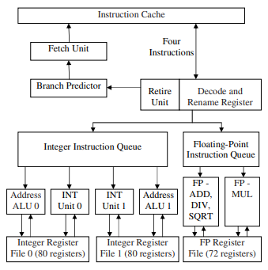
2.3.a.Alpha 21264
The Alpha 21264 (EV6) processor (Figure 10) was introduced in 1998 with a 0.35µm CMOS process technology operating at 600MHz frequency. It is the first Alpha processor designed with an out-of-order issue strategy.
Figure 10

Slide 119
2.3.a.Alpha 21264
The Alpha 21264 has a 4 way issue bandwidth. However, the execution stage supports 6-way issue in a cycle with four integer functional units and two floatingpoint functional units. It is also designed to support 80 in-flight instructions in a processor. Alpha 21264 has only two floating-point units and a single physical register file. Both floating-point units are fully pipelined.
The Alpha 21264 processor is implemented with a 64-KB, two-way set-associative L1 data cache. The earlier model of the processor (Alpha 21164) had only a 8-KB data cache which resulted in many more cache misses than the more modern 21264 processor. It now has a huge L1 data cache. As a result, the access latency to the data cache requires two clock cycles. However, two concurrent accesses to the level 1 data cache are supported.

Slide 120
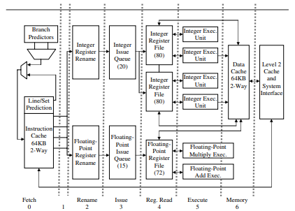
2.3.Alpha 21264
Figure 11 shows a detailed description of the Alpha 21264 pipeline. In its basic inception, an instructions is required to go through all seven stages until it can write back the results. Since the 64KB data cache needs two clock cycles to deliver the data, load/store pipeline operations require two more clock cycles than normal operations.
Figure 11

Slide 121
2.3.Alpha 21264
One distinct feature of the Alpha 21264 is in that the fetch stage uses line and way prediction for the next instruction to fetch. It is possibly achieved by using the next line predictor and set predictor. The purpose of those predictors are similar to that of the Branch Target Buffer: it provides the address for the next instruction to fetch. As for the control flow prediction, the processor still has a branch prediction mechanism: a hybrid branch predictor is implemented. One more interesting feature of the processor is the load hit/miss prediction which helps to schedule load instructions.

Slide 122
2.3.MIPS R10000
The MIPS R10000 is based on the previous MIPS processors. The previous MIPS processors were mainly single issue pipelined RISC processors. The MIPS R10000 is the first out-of-order issue superscalar processor which is implemented for the MIPS IV ISA. The MIPS R1000 processor fetches four instructions from the instruction cache in every cycle and decodes those instructions. Any branch is immediately predicted upon detection.

Slide 123
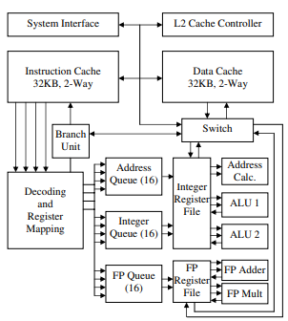
2.3.MIPS R10000
The first implementation of the MIPS IV ISA architecture is the 4-issue superscalar processor (R8000). The R8000 is able to execute two ALU and two memory operations per cycle. However, the R8000 processor does not have a dynamic scheduling capability. The most distinguishable advantage of the R10000 (Figure 12) is the out-of-order execution feature which is enabled by the dynamic scheduling.

Slide 124
2.3.MIPS R10000
Four instructions can be fetched and decoded at each clock cycle. Those instructions are stored in one of the three instruction queues after the decoding stage. Each queue has 16 entries for instructions. Those issue queues can also read operands from the register file. Once the register dependencies are resolved and functional units are available, the instructions can be executed in one of the five functional units. Normal integer operations take one clock cycle while load store instructions requires two clock cycles in the execution stage. The floating-point operations need three clock cycles for their execution.
Both level 1 caches are 32KB in size and two-way interleaved. The core processor chip also controls a large external level 2 cache. The R10000 is implemented with a 64-bit split-transaction system bus used to communicate with the outside of the chip. Up to four R10000 chips can be integrated using this bus architecture.

Slide 125
Dependencies Review
Each of the three data dependencies
True data dependencies (read before write)
Antidependencies (write before read)
Output dependencies (write before write)
manifests itself through the use of registers (or other storage locations)

Slide 126
Dependencies Review
True dependencies represent the flow of data and information through a program
Anti- and output dependencies arise because the limited number of registers mean that programmers reuse registers for different computations
When instructions are issued out-of-order, the correspondence between registers and values breaks down and the values conflict for registers

Slide 127
Storage Conflicts and Register Renaming
Storage conflicts can be reduced (or eliminated) by increasing or duplicating the troublesome resource
Provide additional registers that are used to reestablish the correspondence between registers and values
Allocated dynamically by the hardware in SS processors
Register renaming – the processor renames the original register identifier in the instruction to a new register (one not in the visible register set)
R3 := R3 * R5
R4 := R3 + 1
R3 := R5 + 1
R3b := R3a * R5a
R4a := R3b + 1
R3c := R5a + 1

Slide 128
Storage Conflicts and Register Renaming
The hardware that does renaming assigns a “replacement” register from a pool of free registers and releases it back to the pool when its value is superseded and there are no outstanding references to it

Slide 129
Multiple-Issue Processor Styles
Static multiple-issue processors (aka VLIW)
Decisions on which instructions to execute simultaneously are being made statically (at compile time by the compiler)
E.g., Intel Itanium and Itanium 2 for the IA-64 ISA – EPIC (Explicit Parallel Instruction Computer)
Dynamic multiple-issue processors (aka superscalar)
Decisions on which instructions to execute simultaneously are being made dynamically (at run time by the hardware)
E.g., IBM Power 2, Pentium 4, MIPS R10K, HP PA 8500

Slide 130
Multiple-Issue Datapath Responsibilities
Must handle, with a combination of hardware and software fixes, the fundamental limitations of
Storage (data) dependencies – aka data hazards
Limitation more severe in a SS/VLIW processor due to (usually) low ILP
Procedural dependencies – aka control hazards
Ditto, but even more severe
Use dynamic branch prediction to help resolve the ILP issue
Resource conflicts – aka structural hazards
A SS/VLIW processor has a much larger number of potential resource conflicts
Functional units may have to arbitrate for result buses and register-file write ports
Resource conflicts can be eliminated by duplicating the resource or by pipelining the resource

Slide 131
Instruction Issue and Completion Policies
Instruction-issue – initiate execution
Instruction lookahead capability – fetch, decode and issue instructions beyond the current instruction
Instruction-completion – complete execution
Processor lookahead capability – complete issued instructions beyond the current instruction
Instruction-commit – write back results to the RegFile or D$ (i.e., change the machine state)
In-order issue with in-order completion
In-order issue with out-of-order completion
Out-of-order issue with out-of-order completion
Out-of-order issue with out-of-order completion and in-order commit

Slide 132
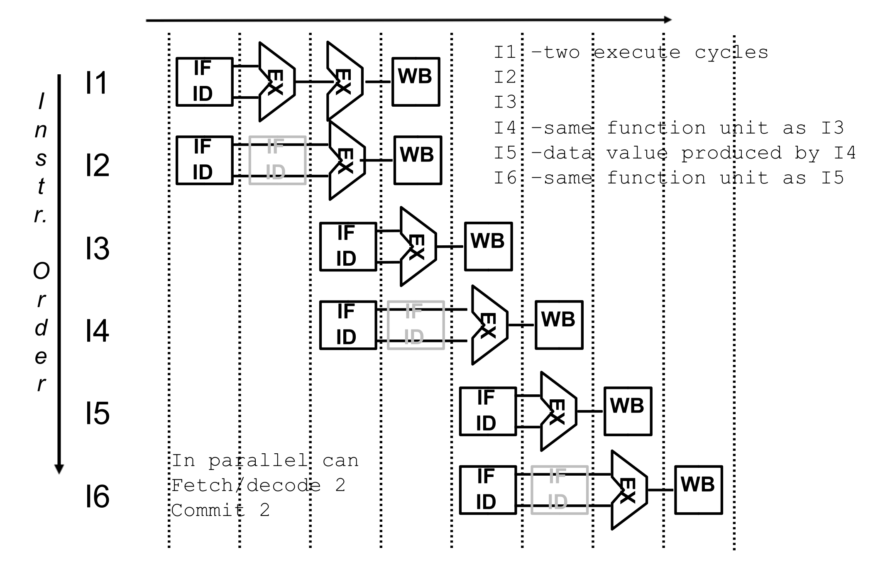
In-Order Issue with In-Order Completion

Slide 133
In-Order Issue with Out-of-Order Completion
With out-of-order completion, a later instruction may complete before a previous instruction
Out-of-order completion is used in single-issue pipelined processors to improve the performance of long-latency operations such as divide
When using out-of-order completion instruction issue is stalled when there is a resource conflict (e.g., for a functional unit) or when the instructions ready to issue need a result that has not yet been computed

Slide 134
IOI-OOC Example

Slide 135
Handling Output Dependencies
There is one more situation that stalls instruction issuing with IOI-OOC, assume
I1 – writes to R3
I2 – writes to R3
I5 – reads R3
If the I1 write occurs after the I2 write, then I5 reads an incorrect value for R3
I2 has an output dependency on I1 – write before write
The issuing of I2 would have to be stalled if its result might later be overwritten by an previous instruction (i.e., I1) that takes longer to complete – the stall happens before instruction issue
While IOI-OOC yields higher performance, it requires more dependency checking hardware
Dependency checking needed to resolve both read before write and write before write

Slide 136
Out-of-Order Issue with Out-of-Order Completion
With in-order issue the processor stops decoding instructions whenever a decoded instruction has a resource conflict or a data dependency on an issued, but uncompleted instruction
The processor is not able to look beyond the conflicted instruction even though more downstream instructions might have no conflicts and thus be issueable
Fetch and decode instructions beyond the conflicted one, store them in an instruction buffer (as long as there’s room), and flag those instructions in the buffer that don’t have resource conflicts or data dependencies
Flagged instructions are then issued from the buffer without regard to their program order

Slide 137

OOI-OOC Example

Slide 138
VLIW
Very long instruction word or VLIW refers to a processor architecture designed to take advantage of instruction level parallelism
Instruction of a VLIW processor consists of multiple independent operations grouped together.
There are Multiple Independent Functional Units in VLIW processor architecture
Each operation in the instruction is aligned to a functional unit.
All functional units share the use of a common large register file.
This type of processor architecture is intended to allow higher performance without the inherent complexity of some other approaches.

Slide 139
VLIW Compiler
Compiler is responsible for static scheduling of instructions in VLIW processor.
Compiler finds out which operations can be executed in parallel in the program.
It groups together these operations in single instruction which is the very large instruction word.
Compiler ensures that an operation is not issued before its operands are ready.

Slide 140
VLIW Instruction
One VLIW instruction word encodes multiple operations which allows them to be initiated in a single clock cycle.
The operands and the operation to be performed by the various functional units are specified in the instruction itself.
One instruction encodes at least one operation for each execution unit of the device.
So length of the instruction increases with the number of execution units

Slide 141

Block Diagram

Slide 142

Diagram (Conceptual Instruction Execution)

Slide 143
Working
Long instruction words are fetched from the memory
A common multi-ported register file for fetching the operands and storing the results.
Parallel random access to the register file is possible through the read/write cross bar.
Execution in the functional units is carried out concurrently with the load/store operation of data between RAM and the register file.
One or multiple register files for FX and FP data.
Rely on compiler to find parallelism and schedule dependency free program code.

Slide 144
Advantages of VLIW
Dependencies are determined by compiler and used to schedule according to function unit latencies .
Function units are assigned by compiler and correspond to the position within the instruction packet.
Reduces hardware complexity.
Tasks such as decoding, data dependency detection, instruction issues etc. becoming simple
Ensures potentially higher Clock Rate.
Ensures Low power consumption

Slide 145
Disadvantages of VLIW
Higher complexity of the compiler
Compatibility across implementations : Compiler optimization needs to consider technology dependent parameters such as latencies and load-use time of cache.
Unscheduled events (e.g. cache miss) stall entire processor .
Code density: In case of un-filled opcodes in a VLIW, memory space and instruction bandwidth are wasted i.e. low slot utilization.
Code expansion: Causes high power consumption

Slide 146
Reading Assignment 3
2

Slide 147
Cache Coherence
Nhóm 1
1870583 Chu XuânTình
1870584 Trần ThànhĐạt
1870387 Lê vănDuẫn
1970017 PHAN VĂN HƯNG
1670967 NGUYỄN NGỌC THÀNH
1970133 TRẦN QUỐC TRÍ

Slide 148
Shared Memory Model
Many parallel programs communicate through shared memory
Proc 0 writes to an address, followed by Proc 1 reading
This implies communication between the two
Each read should receive the value last written by anyone
This requires synchronization (what does last written mean?)
What if Mem[A] is cached (at either end)?
Proc 0
Mem[A] = 1
Proc 1
…
Print Mem[A]

Slide 149
Cache Coherence
Basic question: If multiple processors cache the same block, how do they ensure they all see a consistent state?
P1
P2
Interconnection Network
1000
x
Main Memory

Slide 150
The Cache Coherence Problem
P1
P2
ld r2, x
1000
Interconnection Network
1000
x
Main Memory

Slide 151
The Cache Coherence Problem
P1
P2
ld r2, x
ld r2, x
1000
1000
Interconnection Network
x
1000
Main Memory

Slide 152
The Cache Coherence Problem
P1
P2
ld r2, x
ld r2, x
add r1, r2, r4
st x, r1
2000
1000
Interconnection Network
1000
x
Main Memory

Slide 153
The Cache Coherence Problem
P1
P2
ld r2, x
ld r2, x
add r1, r2, r4
st x, r1
2000
1000
Should NOT load 1000
ld r5, x
Interconnection Network
1000
x
Main Memory

Slide 154
Maintaining Coherence
Need to guarantee that all processors see a consistent value (i.e., consistent updates) for the same memory location
Writes to location A by P0 should be seen by P1 (eventually), and all writes to A should appear in some order
Coherence needs to provide:
Write propagation: guarantee that updates will propagate
Write serialization: provide a consistent global order seen by all processors
Need a global point of serialization for this store ordering

Slide 155
Hardware Cache Coherence
Basic idea:
A processor/cache broadcasts its write/update to a memory location to all other processors
Another cache that has the location either updates or invalidates its local copy

Slide 156
Coherence: Update vs. Invalidate
How can we safely update replicated data?
Option 1 (Update protocol): push an update to all copies
Option 2 (Invalidate protocol): ensure there is only one copy (local), update it
On a Read:
If local copy isn’t valid, put out request
(If another node has a copy, it returns it, otherwise memory does)

Slide 157
Coherence: Update vs. Invalidate
On a Write:
Read block into cache as before
Update Protocol:
Write to block, and simultaneously broadcast written data to sharers
(Other nodes update their caches if data was present)
Invalidate Protocol:
Write to block, and simultaneously broadcast invalidation of address to sharers
(Other nodes clear block from cache)

Slide 158
Update vs. Invalidate Tradeoffs
Which do we want?
Write frequency and sharing behavior are critical
Update
+ If sharer set is constant and updates are infrequent, avoids the cost of invalidate-reacquire (broadcast update pattern)
- If data is rewritten without intervening reads by other cores, updates were useless
- Write-through cache policy ➔ bus becomes bottleneck
Invalidate
+ After invalidation broadcast, core has exclusive access rights
+ Only cores that keep reading after each write retain a copy
- If write contention is high, leads to ping-ponging (rapid mutual invalidation-reacquire)

Slide 159
Two Cache Coherence Methods
How do we ensure that the proper caches are updated?
Snoopy Bus [Goodman ISCA 1983, Papamarcos+ ISCA 1984]
Bus-based, single point of serialization for all requests
Processors observe other processors’ actions
E.g.: P1 makes “read-exclusive” request for A on bus, P0 sees this and invalidates its own copy of A
Directory [Censier and Feautrier, IEEE ToC 1978]
Single point of serialization per block, distributed among nodes
Processors make explicit requests for blocks
Directory tracks ownership (sharer set) for each block
Directory coordinates invalidation appropriately
E.g.: P1 asks directory for exclusive copy, directory asks P0 to invalidate, waits for ACK, then responds to P1

Slide 160
Directory Based Coherence
Idea: A logically-central directory keeps track of where the copies of each cache block reside. Caches consult this directory to ensure coherence.
An example mechanism:
For each cache block in memory, store P+1 bits in directory
One bit for each cache, indicating whether the block is in cache
Exclusive bit: indicates that a cache has the only copy of the block and can update it without notifying others
On a read: set the cache’s bit and arrange the supply of data
On a write: invalidate all caches that have the block and reset their bits
Have an “exclusive bit” associated with each block in each cache

Slide 161
Snoopy Cache Coherence
Idea:
All caches “snoop” all other caches’ read/write requests and keep the cache block coherent
Each cache block has “coherence metadata” associated with it in the tag store of each cache
Easy to implement if all caches share a common bus
Each cache broadcasts its read/write operations on the bus
Good for small-scale multiprocessors
What if you would like to have a 1000-node multiprocessor?

Slide 162
A Simple Snoopy Cache Coherence Protocol
Caches “snoop” (observe) each other’s write/read operations
A simple protocol:
PrRd/--
PrWr / BusWr
Write-through, no-write-allocate cache
Actions: PrRd, PrWr, BusRd, BusWr
Valid
BusWr
PrRd / BusRd
Invalid
PrWr / BusWr

Slide 163
Snoopy Cache vs. Directory Coherence
Snoopy Cache
+ Miss latency (critical path) is short: miss → bus transaction to memory
+ Global serialization is easy: bus provides this already (arbitration)
+ Simple: adapt bus-based uniprocessors easily
- Relies on broadcast messages to be seen by all caches (in same order):
→ single point of serialization (bus): not scalable
→ need a virtual bus (or a totally-ordered interconnect)
Directory
- Adds indirection to miss latency (critical path): request → dir. → mem.
- Requires extra storage space to track sharer sets
Can be approximate (false positives are OK)
- Protocols and race conditions are more complex (for high-performance)
+ Does not require broadcast to all caches
+ Exactly as scalable as interconnect and directory storage (much more scalable than bus)
Notes:
Make reference to SGI Origin paper

Slide 164
A More Sophisticated Protocol: MSI
Extend single valid bit per block to three states:
M(odified): cache line is only copy and is dirty
S(hared): cache line is one of several copies
I(nvalid): not present
Read miss makes a Read request on bus, transitions to S
Write miss makes a ReadEx request, transitions to M state
When a processor snoops ReadEx from another writer, it must invalidate its own copy (if any)
S→M upgrade can be made without re-reading data from memory (via Invalidations)

Slide 165
MSI State Machine
M
BusRd/Flush
PrWr/BusRdX
PrWr/BusRdX
PrRd/--
PrWr/--
BusRdX/Flush
PrRd/BusRd
S
I
PrRd/--
BusRd/--
BusRdX/--

Slide 166
The Problem with MSI
A block is in no cache to begin with
Problem: On a read, the block immediately goes to “Shared” state although it may be the only copy to be cached (i.e., no other processor will cache it)
Why is this a problem?
Suppose the cache that read the block wants to write to it at some point
It needs to broadcast “invalidate” even though it has the only cached copy!
If the cache knew it had the only cached copy in the system, it could have written to the block without notifying any other cache → saves unnecessary broadcasts of invalidations

Slide 167
Thank you
Q&A

